Slide 1
ERIKS MRO Integrated – Strategy Go
Jessica Duyen Pham, 11 Dec 2017

Slide 2
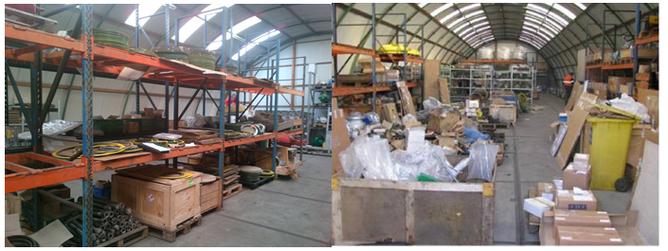
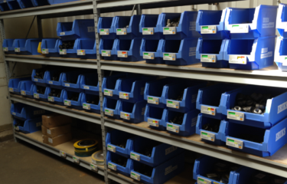
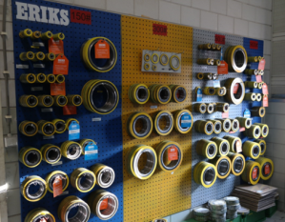
Objective
To seek a Strategy Go to :
Consolidate and centralize spare parts sourcing process into 1 supplier - ERIKS
Create SAP contract and contract agreement with ERIKS for the year 2018

Slide 3
Why outsourcing?
MRO < 10% of the total spend
High stock (WC)
Little spend takes a lot of time
> 80% of the total number of suppliers
Fragmented supplier base
Limited standardization
> 90% of the total orders/orderlines
Local focus / little synergy

Slide 4
Background
DID YOU KNOW
ERIKS project has been kicked start in Vietnam since Jan 2016; but over 1 year, it generates little to no savings due to many reasons
FACTORS affect PROJECT VISIBILITY
FC
FC
3-month contract pending
C-Work Data imperfect
Delay mapping & matching
Complete new set of staff
9/10 related personels believe this project is NOT FEASIBLE
However, the PROJECT’s APPROACH is the MAIN factor

Slide 5
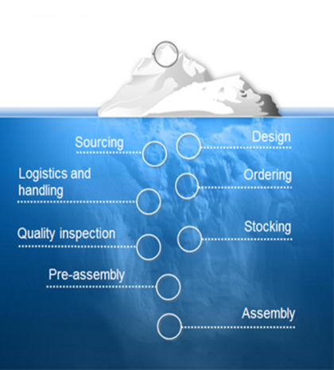
Amended Approach
Original Approach
Amended Approach
PM + BDCM
Step 1: Outsource everything except OEM - 60-70% of total spareparts
Step 1: Map & Match what is available
- BDCM – 30% of total spareparts
BDCM
Hard savings
Step 2: Improve & Save money
TCO savings
Step 2: Quote what is matched
- 15% of total spare parts
Step 3: VMI implementation
Step 3: Buy what is agreed in price
- 5-8% of total spare parts
“The price of light is less than the cost of darkness”

Slide 6
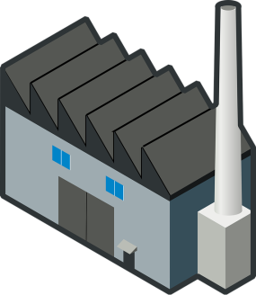
Flow: Current and New
Current Flow before ERIKS
We are currently sourcing >7,000 sparepart items from >60 suppliers.
FCV collect goods at ports and pay all related fees (import duty, WHT, service charge, etc...), and ship to respective plants
Exwork, CIF, CIP,...
>15 oversea suppliers
Port
>45 local suppliers
FCV
FCH

Slide 7
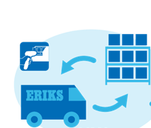
Flow: Current and New
New Flow with ERIKS – Step 1: Outsourcing
3. Goods are received, collected data (P/N, spec, manufacturer,...), and stored at ERIKS warehouse ready for PO from FCV
Oversea suppliers
ERIKS warehouse (5-10’ from FCV)
4. ERIKS deliver DDP to respective plants
Local suppliers
1. ERIKS sources from current suppliers/ direct manufacturer
2. ERIKS takes care of collect goods at ports and pay all related fees (import duty, WHT, service charge, etc...)
FCV
FCH
Notes:
ERIKS warehouse address: No 8 Street, Song Than IP, Binh Duong Province, Ho Chi Minh

Slide 8
Cost drivers
Activities
Product performance
Technical support
Process output
Reduction of maintenance costs & downtime
Process downtime
Production uptime optimisation
Energy costs
Part standardization
OEM conversions
Brand switch
Brand standardization
Right product > right application
Increased product lifetime
Energy savings
Redesigned processes
Continuous improvement

Slide 9
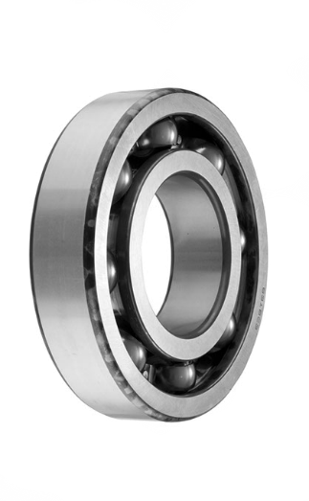
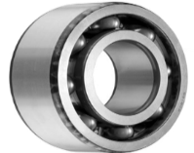
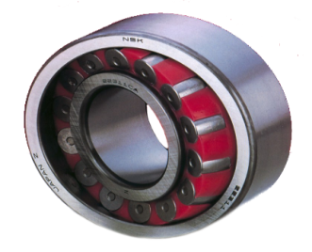
Flow: Current and New
Your requirements
ERIKS helps you to select the best product for the job
New Flow with ERIKS – Step 2: Improve & Save money
Once data is collected, ERIKS recommends the best products for the jobs with 4 options, and FCV authorized the offer.
Each year, ERIKS’ KPI is to generate a hard savings of 3%. Reported to FCV procurement
Option 1
OEM
Option 2
Industry standard (Availability)
Option 3
Alternative (Cost saving)
Option 4
Upgraded part (Enhanced performance)
Change control & authorisation
SKF
NSK
Timken
ERIKS recommends, you authorize

Slide 10
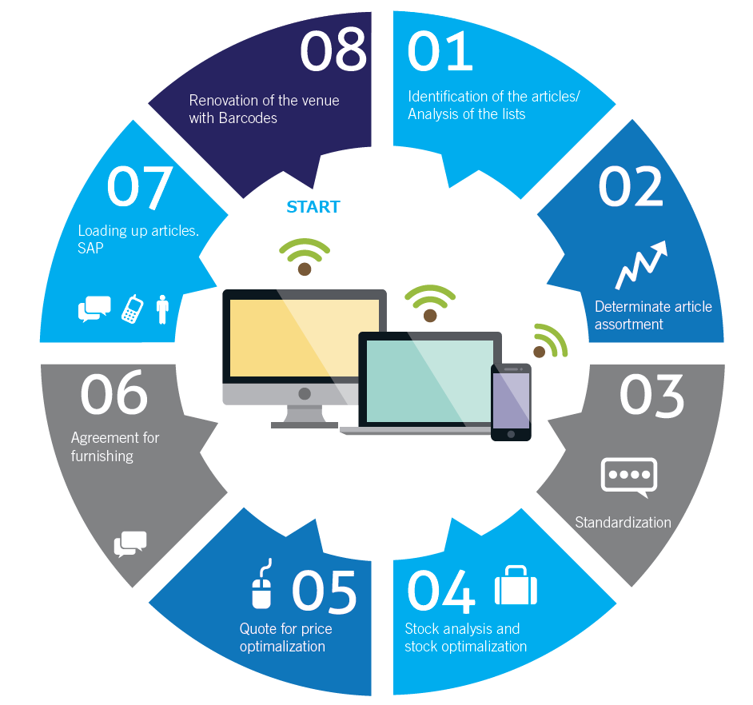
Step 3: VMI Implementation Flow

Slide 11
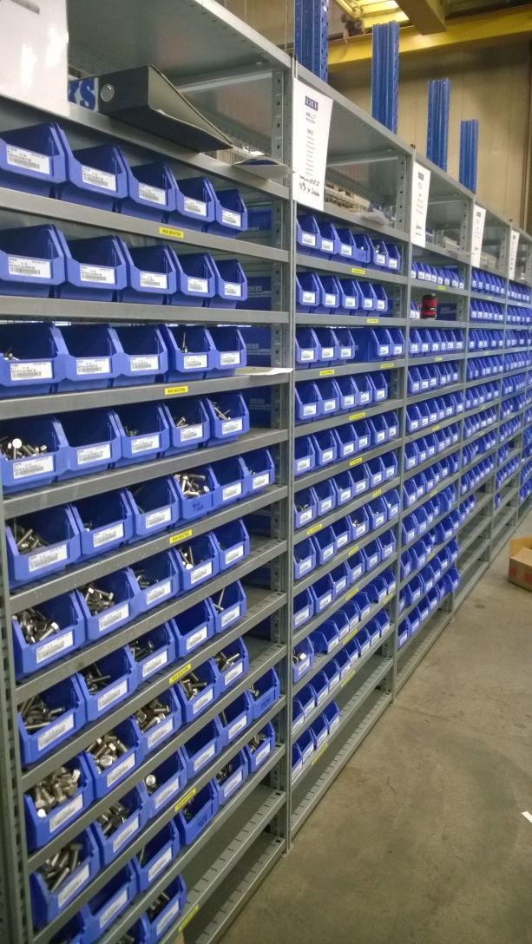
Step 3: VMI Implementation Flow
Key Benefits
Automatic replenishment via a container system (two-bin/KANBAN) or via scanning (shop floor) by the ERIKS employees
Periodic replenishment tailored to your needs
Containers with labels showing product information and quantities
No order entry
No need for booking in, goods receipt and entry of items
No FTE necessary for issue registration
Reporting on monthly consumption statement
Handling of stock management and changes in the floor stocks
Permanent ERIKS employees ensure good communication
ERIKS has many years of experience with leading customers in both the management of floor stocks (VMI) and warehouse management in general.
ERIKS currently manages 113 floor stocks in the Netherlands. A good example of this is our customer Royal FrieslandCampina, where ERIKS looks after the VMI at more than 20 locations

Slide 12
Make soft savings harder
Benefits | With Current suppliers | With ERIKS Target | With ERIKS Achieved
Price Gap | Price increases every year in a pattern of 5-10% due to inflation, labor cost, currency, fuel price, etc.. | A margin of 12% is allowed when ERIKS sell non-core activities parts | Overseas: 6% Local spare parts: 5% Exceptionally high price: replaced P/N, Items bought many years ago
Vendor Management | - Preventive Maint.: 60 supplier > 15 overseas suppliers > 45 local suppliers | 80% supplier reduction = 48 suppliers | 81% supplier reduction = 49 suppliers
Incoterm | 9 suppliers with Exwork Incoterm | N/A | ERIKS offer DDP => Reduce Import duty + WHT + Service charge: 464,615,017 + 298,002 + 61,971,517 = 526,884,536 VND ~ 20,300EUR
Payment term | 0EM: 4 suppliers Z014 + 14EM: 3 Suppliers Z030 + 30EM: 19 suppliers - 45EM: 2 suppliers 60EM: 10 suppliers 75EM: 1 supplier 105Em: 3 suppliers No/obsolete PT: 7 suppliers | 1st year: 75 EoM 2nd year on: 105 EoM | 1st year: 75 EoM 2nd year on: 105 EoM
Currency Exchange | Exchange Rate pattern in 2018: USD: Increased 1.286% EUR: Increased 15.86% | N/A | 1USD= 22,839VND, 1EUR= 27,358VND => Fixed for 1 year
DIO | 0.6 days | N/A | Calculating...

Slide 13
Key Considerations
Corporation of the Technical team
Verify replaced P/N, work together with ERIKS to identify the parts.
Verify cash improvements with better payment term
Calculate the cash improvement
Verify extra cost on top of spare parts price
Custom clearance
Import Duty
Service Charge
Logistics charge
DIO
Verify other added beneficials
All items are priced, fixed currency for 1 year, fixed incoterm for plant use and for SUMMIT.
Hands off sourcing, ordering, storing, restocking, etc...

Slide 14
Project Team
Procurement:
Jessica Duyen Pham, PF Buyer (Lead)
Technical Engineer:
Pham Hong Son (FCV super user)
Tran Thi Tuyet Nhung (FCH super user)
Finance (where needed):
??
Human Resource (where needed):
??

Slide 15
Timing
FCV TCO Project Timeline
Activity | Place |  | Action |  | 2015 |  | 2016 |  | 2017 |  |  |  |  |  |  |  |  |  |  |  |  |  |  |  |  |  | 2018
 | BD | HN | FCV | ERIKS | Nov-Dec |  | Jan-Dec |  | Jan-April |  | May |  | June |  | July |  | Aug |  | Sept |  | Oct |  | Nov |  | Dec |  | Jan |  | Feb |  | Mar |  | Apr |  | May |  | Jun |  | Jul |  | Aug
Phase 1: Health Check | X | X | X | X
Phase 2: Mapping & Matching
Binh Duong Plant | X
HaNam Plant |  | X
Phase 3: Amend Approach to Outsource
Trial - Q3 Maintenance | X |  | X | X
Performance Evaluate | X |  | X
Trial - Q4 Maintenance |  | X | X | X
Performance Evaluate |  | X | X
Phase 4: Contract & SAP Contract
SAP contract Creation | X | X | X | X
Contract Negotiation |  |  | X | X
Vendor Reduction, Cost savings Calculation |  |  | X
Phase 5: Alternative Parts - TCO Savings
List of ERIKS alternative parts - non manufactured | X | X |  | X
List of ERIKS alternative parts - ERIKS manufactured | X | X |  | X
Alternative part trial plan (short interval) |  |  | X
Non-food contact spare parts Trial run in BD | X |  | X | X
Non-food contact spare parts Trial run in HN |  | X | X | X
Food contact spare parts trial run in BD | X |  | X | X
Food contact spare parts trial run in HN |  | X | X | X
Performance evaluate, cost savings | X | X | X
Phase 6: VMI Setup
Identify critical, high-turnover, consumables | X | X | X | X
Identify VMI stocking requirements | X | X | X | X
VMI setup in plant BD | X |  |  | X
VMI setup in plant HN |  | X |  | X
VMI kick-off |  |  | X | X

Slide 16
Thank you

