Slide 1
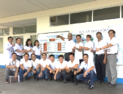
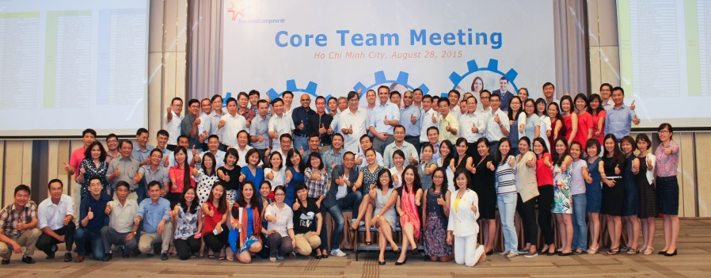
Asian Procurement Day
Location: Da Nang
Date: from 13 – 16 March

Slide 2
List of Content
Cost Analysis – March 14-16
Cost Analysis – March 20-23
Maps
Photos of 2 top choices.
Suggestions

Slide 3
1. March 14-16
COST
 | Hyatt | Risemount | Intercontinental | Naman Retreat
SGL Room | 3,900,000 | 2,300,000 | 9,800,000 | -
DBL Room | - | - | - | 3,115,000
Training room full day | 1,262,000 | N/A | 2,080,000 | N/A
Training room half day | 1,005,000 | N/A | 1,850,000 | N/A
Conference room half day | 777,000 in Vinpearl | 470,000 | 600,000 | 1,600,000
Tech&amenity | included | rent exclusively | included | included
Breakfast & Lunch | included | included | included | included
Transportation (round-trip) | 350,000 | 160,000 | still checking | N/A
Breakout room each | included | N/A | included | N/A
Team building | complimentary venue | outdoor 1,000,000++/hr, indoor 10,000,000++/ballroom | not included in quotation for venue price | not included in quotation
Dinner | 910,000 | 500,000 | 2,340,000 | 1,212,000
Beverage price for dinner (2 hours free flow) | 825,000 | not included in quotation - checking with the hotel | 810,000 | 750,000
Total
PROS and CONS
Location | 15 min from airport, 10 min to downtown | 10 min to airport, 5 min to downtown | 35 min to airport, 30 min to downtown | 25 min to airport, 20 min to down town
Remark | Free access to Fitness Center, sauna and steam room. Plenty of meeting rooms at the same rates | no small meeting room, only 1 big conference room (cap. 600) | complimentary 3 rooms for 45 fully paid and materialized roooms, 2 upgrades to Club room | free access to fitnes center, sauna and steam room, complimentary 1 spa treatment/person/day, complementary shuttle bus to Da Nang and Hoi An
Meeting Room | Big Conference room is not available - suggested to outsource from Vinpearl resort (10 min walking distance) | LCD projector to be rented exclusively |  | no small meeting rooms
Summary

Slide 4
2. Cost Analysis – March 20-23
COST
 | Hyatt | Risemount | Intercontinental | Pullman | Naman Retreat
SGL Room | 3,900,000 | 2,300,000 | 9,800,000 | 3,973,000 | 0
DBL Room | 0 | 0 | 0 | 0 | 3,115,000
Training room | 1,262,000 | N/A | 2,080,000 | 1,625,000 | N/A
Training room half day | 1,005,000 | N/A | 1,850,000 | 1,850,000 | N/A
Conference room | 777,000 in Vinpearl | 570,000 | 600,000 | 570,000 | 1,375,000
Tech&amenity | included | rent exclusively | included | included | included
Breakfast & Lunch | included | included | included | included | included
Transportation (round-trip) | 350,000 | 160,000 | still checking | no quotation | N/a
Breakout room each | included | N/A | included | N/A | n/a
Team building | complimentary venue | outdoor 1,000,000++/hr, indoor 10,000,000++/ballroom | not included in quotation for venue price | 6,000,000 beach fee
Dinner | 910,000++ | 500,000++ | 2,340,000 | 736,000++
Beverage price for dinner (2 hours free flow) | 825,000 | not included in quotation - checking with the hotel | 810,000 | not included in quotation - checking with hotel
Total
PROS and CONS
Location | 15 min from airport, 10 min to downtown | 10 min to airport, 5 min to downtown | 35 min to airport, 30 min to downtown | 15 mins to airport, 10 mins to downtown | 25 min to airport, 20 min to down town
Remark | Free access to Fitness Center, sauna and steam room. Plenty of meeting rooms at the same rates | no small meeting room, only 1 big conference room (cap. 600) | complimentary 3 rooms for 45 fully paid and materialized roooms, 2 upgrades to Club room | Printing fee: VND225,000/sqm • Stage set up free in the ballroom. | free access to fitnes center, sauna and steam room, complimentary 1 spa treatment/person/day, complementary shuttle bus to Da Nang and Hoi An
Meeting Room | Big Conference room is not available - suggested to outsource from Vinpearl resort (10 min walking distance) | LCD projector to be rented exclusively | different rates for each room | Tech & amenities (1 set/room) is included | no small meeting rooms
Summary

Slide 5
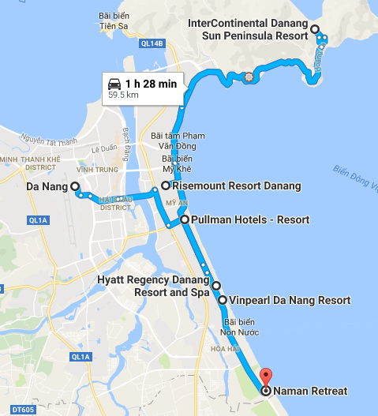
3. Map

Slide 6
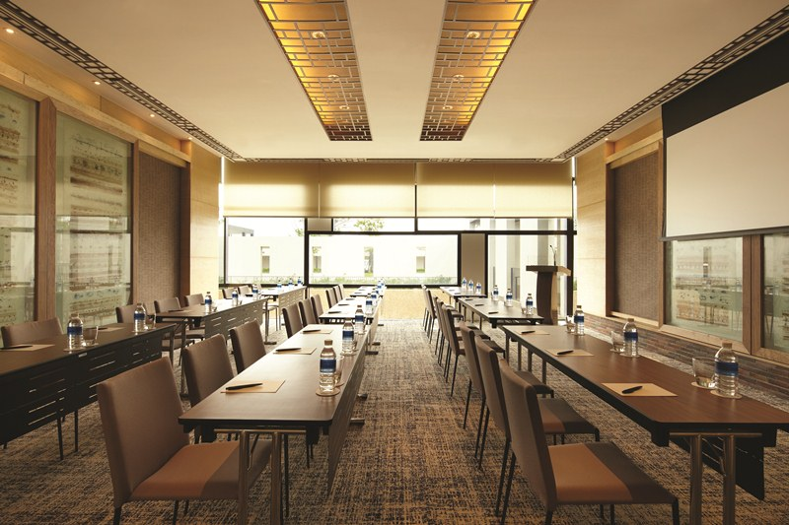
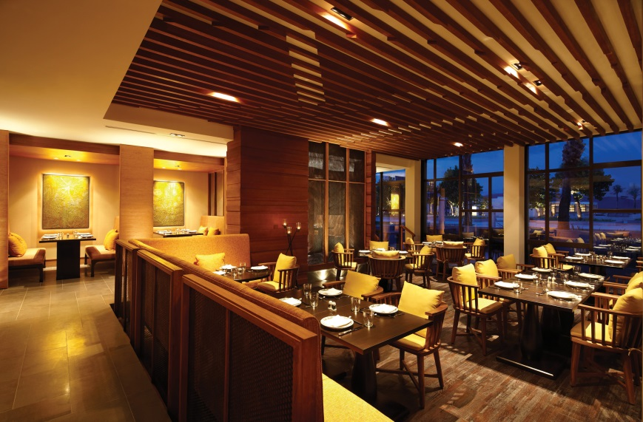
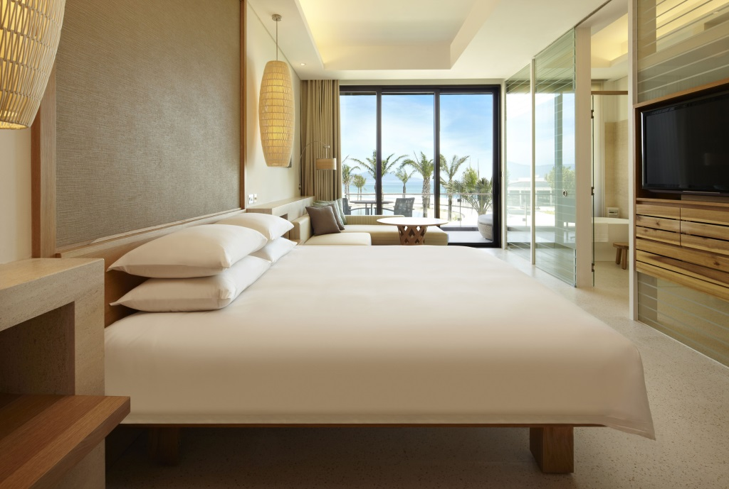
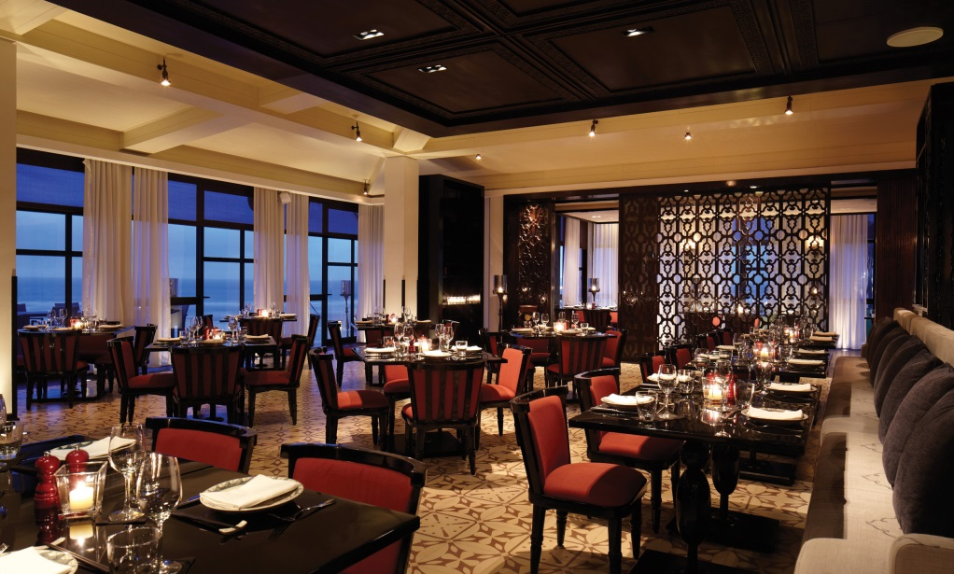
Hyatt

Slide 7
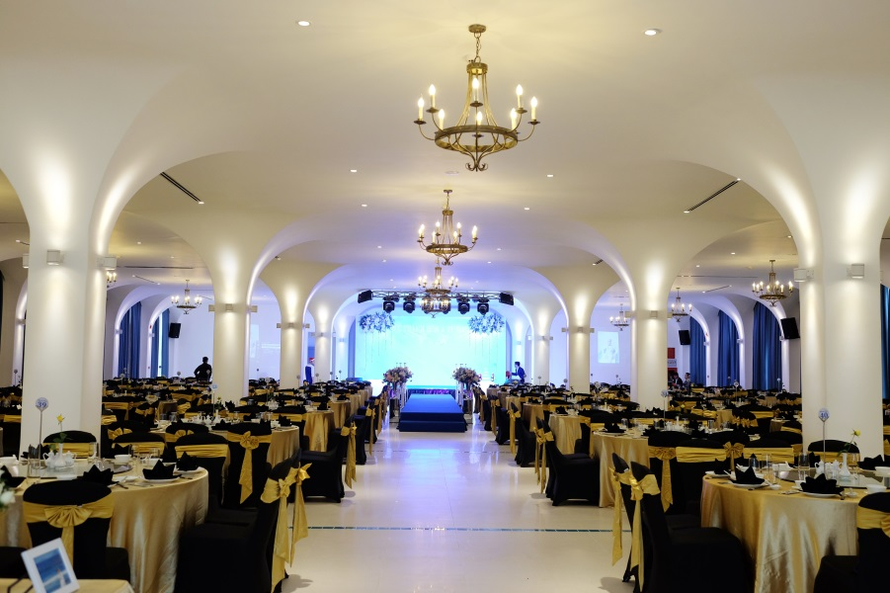
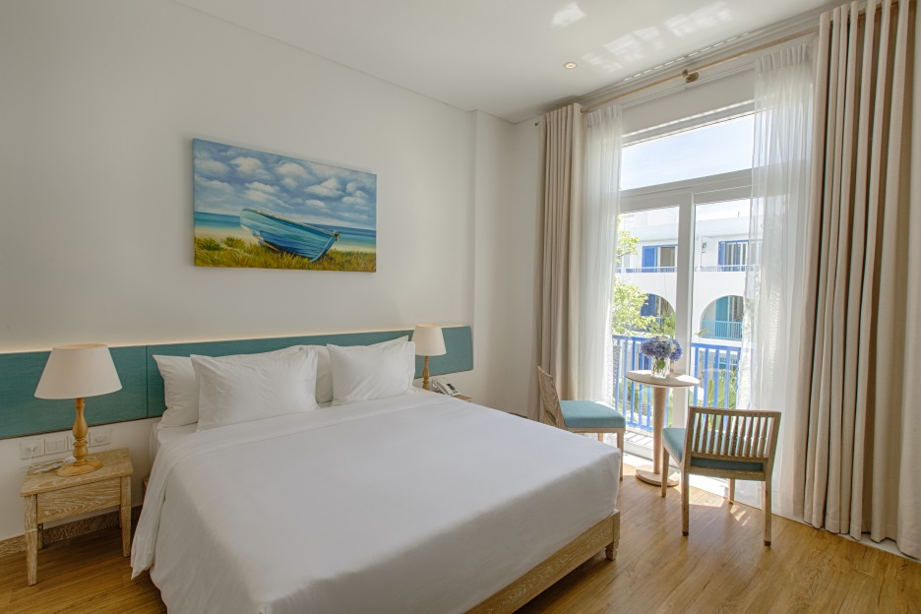
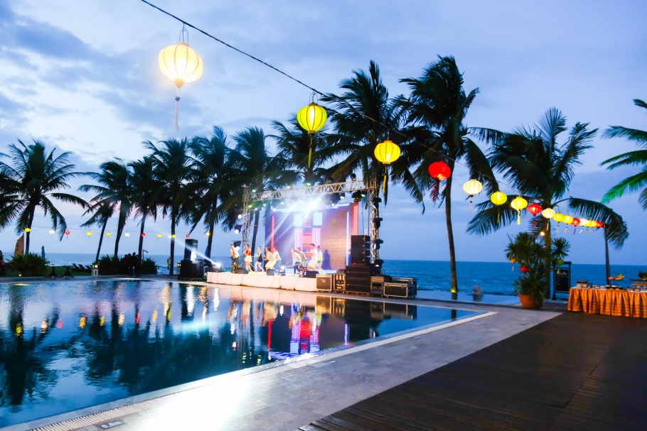
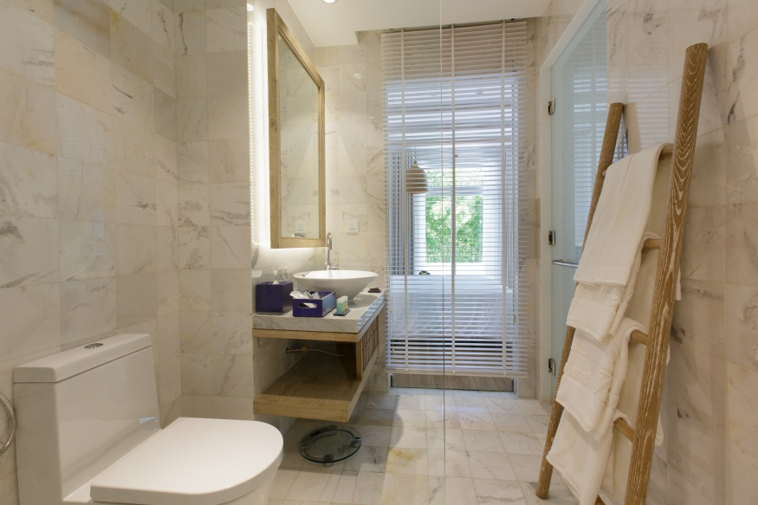
Risemount

Slide 8
Dinner and Gala Dinner
Suggestion:
Dinner at a different venue from the resort. Reason:
Savings
Experience Asian/Vietnamese culture
Relax from training and meeting
2. Quotes for GALA dinner from some venues in Da Nang and Hoi An:
I have some quotes on hand to share.
3. Flight to Danang for on-site survey and negotiation on accommodation, meetings, and transfer package.

